Slide 1
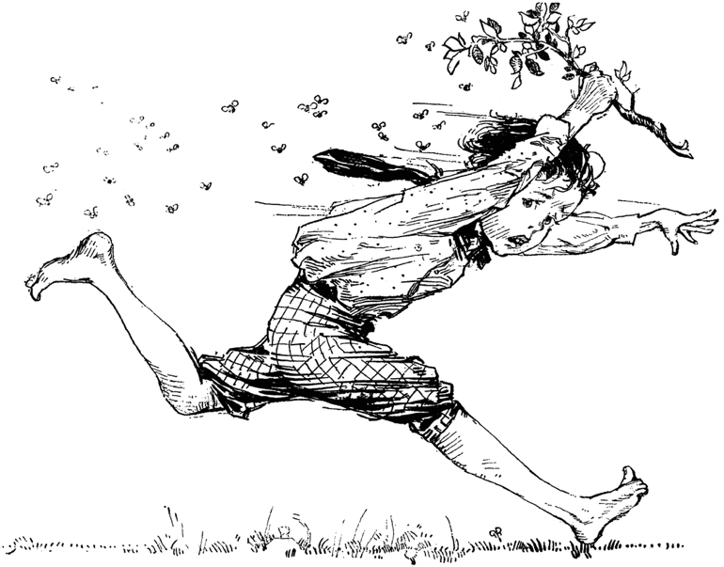
Bee Stings!
Coping with Bee Stings
Normal and Allergic Reactions

Slide 2
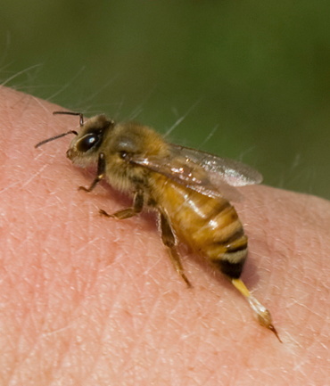
If you work with bees,…
there is one certainty – you will be stung.
Even despite the very best defenses, you will be stung:
Bee stings can have a variety of consequences that must be taken seriously.
Consider the sad story of Don Weakman, Peoria.

Slide 3
Reactions to Bee Stings
Three major types of reactions:
Mild local reactions.
Strong local reactions.
Allergic reactions.
Fortunately, beekeepers tend to become less reactive with the passage of time if they receive stings intermittently.

Slide 4
Mild Local Reactions
Immediate
Pain
Burning, itching
Redness
White wheal at site
Tenderness
Hours/days later
Itching
Redness
Swelling

Slide 5
Strong Local Reactions
Massive swelling around the site of the sting.
Increasing swelling with passage of time.
Can last up to a week without treatment.

Slide 6
Allergic Reactions
Three Types:
Cutaneous allergic reactions
Non-life-threatening systemic allergic reactions
Life-threatening allergic reactions
All forms of allergic reactions should be taken very seriously.

Slide 7
Cutaneous Allergic Reactions
Hives or nettle rash anywhere on body.
Massive swelling remote from sting site.
Generalized itching of the skin.
Generalized redness of skin away from sting.

Slide 8
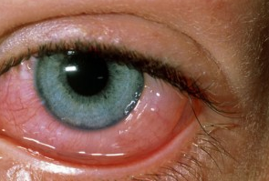
Non-life-threatening Reactions
Allergic rhinitis or conjunctivitis
Minor respiratory problems
Abdominal cramps
Severe gastrointestinal upset
General weakness
Fear of death common

Slide 9
Life-threatening Allergic Reactions
Shock
Unconsciousness
Hypotension
Fainting
Respiratory distress
Laryngeal blockage

Slide 10
Managing Bee Stings
Remove the stinger quickly by scraping.
Many beekeepers take a non-prescription antihistamine to reduce swelling.
Apply treatments such as Soothe Swabs
Carry an Epipen injector

Slide 11
Avoiding Bee Stings
Move slowly and deliberately around bees.
Avoid squeezing and crushing bees.
Avoid hive opening on hot, humid days.
Don’t swat at bees.
Don’t block hive entrance with body.
Wear complete protective coverings.
Avoid dark-colored clothes.
Use your smoker wisely.
Smoke any sting site.
Work your bees at midday when the foragers are out of the hive.

